Slide 1
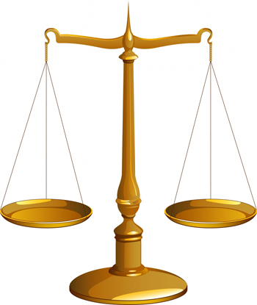
THE ADVERSARY SYSTEM
DISCUSS
SO – NO JUDGEMENT REQUIRED!
“Identify issues and provide points FOR and AGAINST”
DISCUSS the use of the adversary system as a means of achieving justice
But you have to first know…
WHAT the ‘adversary system’ is
and
WHAT is the alternative (if we didn’t have the adversary system, what could we have?)
ISSUE 1
AGAINST
FOR
AGAINST
Name an issue
FOR
AGAINST
THE ADVERSARY SYSTEM
FOR
ISSUE 2
FOR
AGAINST
FOR
AGAINST
Name an issue

Slide 2
THE ADVERSARY SYSTEM
“ADVERSARY”
=
OPPONENT

Slide 3
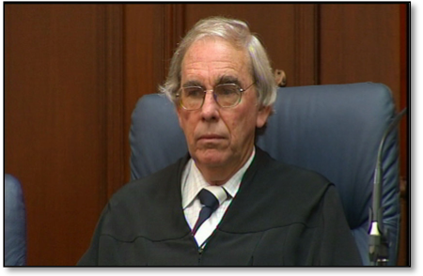
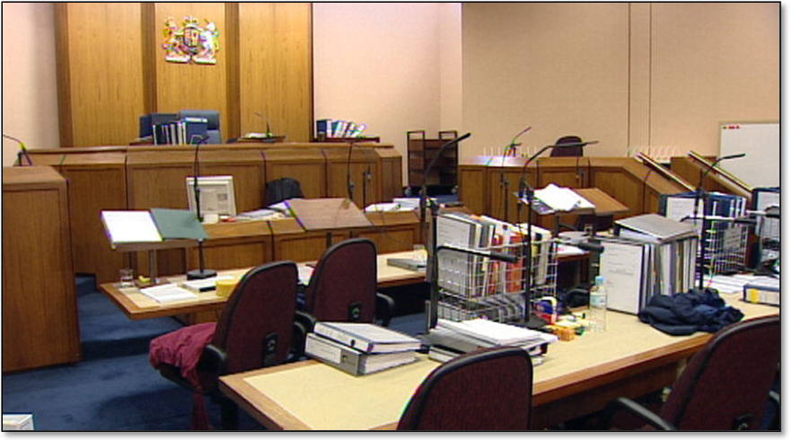
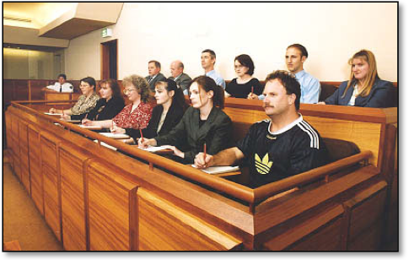
JUDGE
Decides on Questions of Law
Doesn’t do any investigating.
Doesn’t cross examine the witnesses.
Criminal cases: Decides your sentence
THE ADVERSARY SYSTEM
Defendant
Their job is to WIN
Prosecution OR Plaintiff
Their job is to WIN
JURY
Decides on Questions of FACT
Doesn’t do any investigating.
Doesn’t ask questions.
Bunch of randoms.
JURY
Decides on Questions of FACT
Doesn’t do any investigating.
Doesn’t ask questions.
Bunch of randoms.

Slide 4
THE ADVERSARY SYSTEM
PROBLEMS with the adversary system:
Why is our legal system based on the idea that only one person can win and the other person has to lose?
Why can’t jurors ask direct questions? Or at least encouraged to ask the judge questions during the trial?
They’re the ones deciding your case!
Why can’t the judge ask questions?
Why does the side with more money/more lawyers win so often? (e.g. cigarette companies)
Why do cases get decided on a “who won?” basis? Why can’t the GOAL of a trial be to get to the TRUTH, rather than whoever is a better lawyer, or whoever is more persuasive?

Slide 5
THE ADVERSARY SYSTEM
But what’s the alternative?
The INQUISITORIAL system
If someone is inquisitive they ask a lot of questions to try and find the truth…

Slide 6
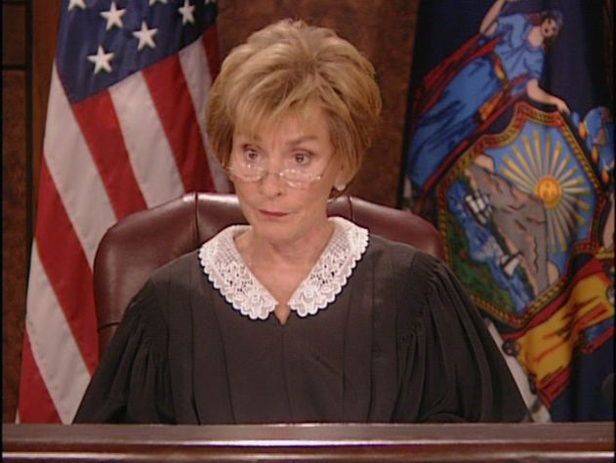
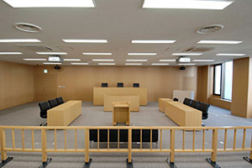
THE ADVERSARY SYSTEM
Judge Judy’s ‘Small Claims Court’ is more like an inquisitorial system.
Japan uses the inquisitorial system (though they are introducing some parts of the adversary system, like juries, recently).

Slide 7
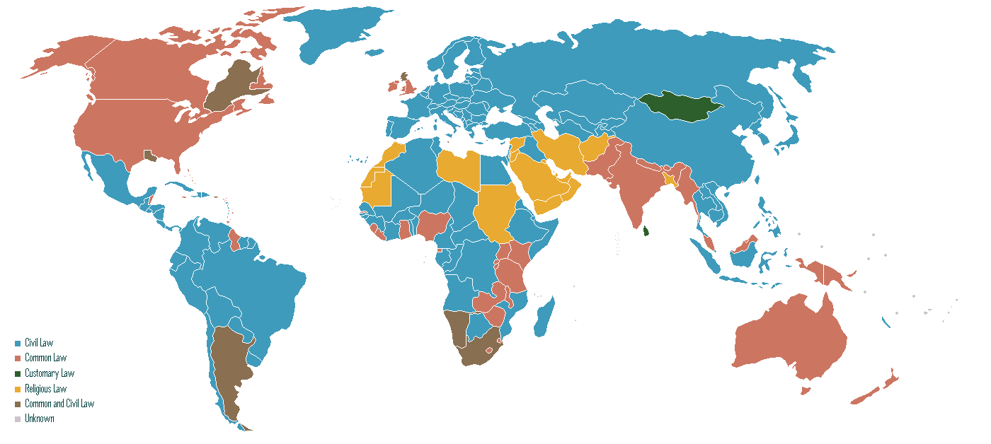
THE ADVERSARY SYSTEM

Slide 8
ADVERSARY SYSTEM
INQUISITORIAL SYSTEM
Prosecution v Defendant
Judge-based
Search for justice
Search for truth
Lawyers in control
Judges in control
Expensive and time-consuming
Faster (trials only last as long as needed)
The government is in charge of prosecuting cases
Lawyer quality is vital
Lawyers play little role
Better lawyer – less chance of conviction
Focus for everyone is on the truth
JURY SYSTEM
The jury is passive (no role in investigation – just sit and wait for evidence to be presented)
Democratic (randomly chosen members of the public)
Still only for indictable offences (which is a small % of all cases)
NON-JURY TRIALS
Except for some VERY serious cases, which MIGHT have 3 judges with 9 jurors)
More concern about “detached” judges making decisions about people’s lives (“They’re not like us – they don’t understand the real world”)
Try to make sure that there is procedural fairness and that there is a balance between the rights of the defendant, the victim and society
ONLY CERTAIN EVIDENCE ALLOWED
Judge rules on which evidence the jury is allowed to hear
Mostly oral evidence (jurors are not expected to read…)
ALL EVIDENCE ALLOWED
Because judges make the decision
A professional judge SHOULD be trusted to ignore any weak evidence
Evidence is mostly written
The defendant has a right to try to prove his/her innocence
BETTER FOR THE DEFENDANT
Defendants have some right to silence
Only ‘reasonable doubt’ is required for not guilty verdict
Can plead guilty (or plea bargain) and get lesser punishment
BETTER FOR THE SOCIETY
NO right to silence for the defendant
No such thing as ‘guilty pleas’ (if you’re guilty, you can’t “do a deal” to get a lesser penalty)

Slide 9
THE ADVERSARY SYSTEM
Japan has an inquisitorial system. Their conviction rate is 99.8%!!!
Compare that to NSW’s 82% conviction rate (across all offences).

Slide 10
THE ADVERSARY SYSTEM
DISCUSS
Provide points for and against the adversary system as a way of achieving justice
“Identify issues and provide points FOR and AGAINST”
DISCUSS the use of the adversary system as a means of achieving justice
ISSUE 1
AGAINST
FOR
AGAINST
Name an issue
FOR
AGAINST
THE ADVERSARY SYSTEM
Firstly, work out the issues that you can use to work out whether it is the best way of achieving justice, then provide points for and against.
FOR
ISSUE 2
FOR
AGAINST
FOR
AGAINST
Name an issue
ISSUE 1: The use of juries
ISSUE 2: The role of judges
ISSUE 3: The use of evidence
ISSUE 4: The importance of lawyers
ISSUE 5: The use of pleas (pleading guilty & plea bargaining)

Slide 11
Questions
Question 1: Using the notes above and page 54 of the textbook, differentiate between the adversary system and the inquisitorial system.
Question 2: Using the notes above, identify the similarities between the adversary system and the inquisitorial system.
Question 3: What is the statistic about Japan, an inquisitorial system, in contrast with Australia? Does this necessarily tell you the inquisitorial system? Why/why not?

