Slide 1
CHARGE NEGOTIATION
Why trials are bad for society:
1. They take a long time
2. They cost a lot of money
3. Sometimes don’t end up with a conviction anyway!
So, prosecutors came up with an idea…
Charge Negotiation
AKA: ‘Plea Bargaining’
Where the
prosecutor AGREES to REMOVE some charges
because
the defendant PLEADS GUILTY to other charges

Slide 2
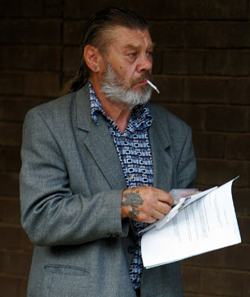
PLEAS
CHARGE NEGOTIATION
INDICTMENT
You are being charged with:
Armed robbery
Armed robbery
Armed robbery
Assault occasioning grievous bodily harm
Assault occasioning grievous bodily harm
Assault occasioning grievous bodily harm
Assault occasioning actual bodily harm
Assault occasioning actual bodily harm
Assault occasioning actual bodily harm
Discharge of a weapon with intent
Discharge of a weapon with intent
Discharge of a weapon with intent
Max: 300 years prison (life…)
Min: Goes free – no justice for victims

Slide 3
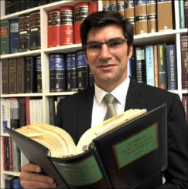
PLEAS
CHARGE NEGOTIATION
What if I plead guilty to one of each, and you remove the rest?
INDICTMENT
You are being charged with:
Armed robbery
Armed robbery
Armed robbery
Assault occasioning grievous bodily harm
Assault occasioning grievous bodily harm
Assault occasioning grievous bodily harm
Assault occasioning actual bodily harm
Assault occasioning actual bodily harm
Assault occasioning actual bodily harm
Discharge of a weapon with intent
Discharge of a weapon with intent
Discharge of a weapon with intent
That will be much easier and cheaper for me, and you’ll end up serving less time in jail for pleading guilty (15%-25%)
Max: 300 years prison (life…)
Min: Goes free – no justice for victims

Slide 4
PLEAS
CHARGE NEGOTIATION
What if I plead guilty to one of each, and you remove the rest?
INDICTMENT
You are NOW being charged with:
Armed robbery
Assault occasioning grievous bodily harm
Assault occasioning actual bodily harm
Discharge of a weapon with intent
That will be much easier and cheaper for me, and you’ll end up serving less time in jail for pleading guilty (15%-25%)

Slide 5
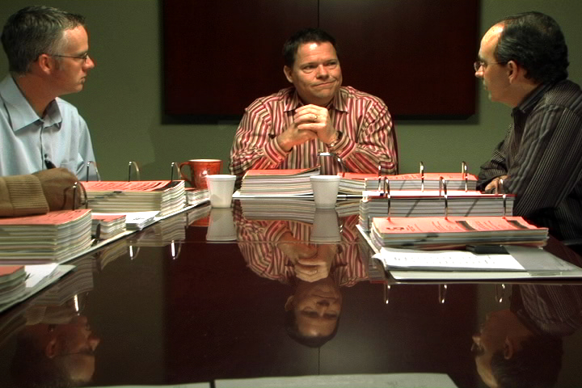
PLEAS
CHARGE NEGOTIATION
This has always been called plea bargaining, but the name has been changed to ‘charge negotiation’…
BARGAINING
NEGOTIATION

Slide 6
PLEAS
CHARGE NEGOTIATION
This has always been called plea bargaining, but the name has been changed to ‘charge negotiation’…
NEGOTIATION
Charge Negotiation
leads to
A Charge Agreement

Slide 7
PLEAS
CHARGE NEGOTIATION
ASSESS the effectiveness of the criminal trial process as a means of achieving justice
PLEAS
CHARGE NEGOTIATION

Slide 8
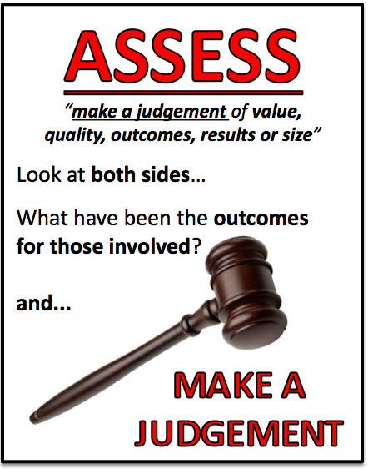
PLEAS
CHARGE NEGOTIATION
ASSESS the effectiveness of the criminal trial process as a means of achieving justice
PLEAS
CHARGE NEGOTIATION
If our goal is to achieve justice, is our current system (of having pleas and using charge negotiation) a GOOD WAY OF MAKING SURE WE GET JUSTICE?

Slide 9
PLEAS
CHARGE NEGOTIATION
But…
Charge negotiation is
extremely controversial
“Why should he get off easy?”
“What about the victim?”
“How is this justice?”

Slide 10
PLEAS
CHARGE NEGOTIATION
WHO DOES ‘CHARGE NEGOTIATION’
ACHIEVE JUSTICE FOR?
3 different views:
The DPP/government
Victims
Judges

Slide 11
PLEAS
CHARGE NEGOTIATION
The DPP’s perspective on charge negotiation…
Advantages:
The court system would not cope without charge negotiation and guilty pleas
Victims and witnesses don’t have to go through the trial process (e.g. being cross-examined)
The accused gets a reduced, but generally NOT an insufficient penalty
It saves about $10,000 per day in court costs (money which COULD go to fighting cases where the defendant is NOT going to plead guilty).
‘Deals outside the courtroom’, The Law Report (2012)
WHEN will the DPP go for a guilty plea through charge negotiation?
(from the DPP Guidelines (2007))
If there is a scared or vulnerable witness/victim (e.g. in sexual assault cases)
If there are multiple charges (e.g. 128 charges for child sexual assault will take ages and cost a fortune to prove – why do all that when the maximum penalty will still be around the same? What’s the difference between 30 years for 10 charges and Life for 128 charges?)

Slide 12
PLEAS
CHARGE NEGOTIATION
The victim’s perspective on charge negotiation…
How much is the victim involved in the process?
It used to be that the victim wouldn’t find out that a “deal” had been made until afterwards
In NSW, the Charter of Victim’s Rights (NSW) was amended in 2009 to include the following point:
Victims have to be consulted (spoken with; have a discussion) BEFORE a charge agreement is decided on
(BUT only for serious cases of violence, incl. sexual violence)
But they DO NOT have to agree with the agreement that has been reached

Slide 13
PLEAS
CHARGE NEGOTIATION
The victim’s perspective on charge negotiation…
Victim’s support group VOCAL agrees that MOST of the time the DPP “gets it right” with charge negotiation, but sometimes victims feel like they were “left out” (which is why the Charter of Victim’s Rights was amended in 2009).
VOCAL would prefer if the victim had to AGREE to the charge agreement as well as the DPP and defendant though.

Slide 14
PLEAS
CHARGE NEGOTIATION
The victim’s perspective on charge negotiation…
The Homicide Victims’ Support Group pushed for more change in 2010:
They felt the requirement of “consultation” was
NOT BEING PROPERLY ENFORCED
Family of murder victim Shane Miles was ‘consulted’, but not kept fully informed (then were surprised by the charge agreement when they went to court → Murder charges had been dropped; defendants pleaded guilty to Manslaughter)
SO NOW: Prosecutors must get a CERTIFICATE signed that proves that the victim (or their family) were properly consulted before the agreement was reached (to improve compliance).

Slide 15
PLEAS
CHARGE NEGOTIATION
The victim’s perspective on charge negotiation…
STILL A BIG PROBLEM:
Any Victim’s Impact Statements that could have been used in a sentencing hearing (after the accused has been found guilty through a trial) CANNOT be used in charge negotiation.
So, the victim has no way of getting across to the judge just how the crime has affected their life.

Slide 16
PLEAS
CHARGE NEGOTIATION
The judge’s perspective on charge negotiation…
A.C.T case - R v Alchin (2008)
A guy breached an AVO and choked his girlfriend until she passed out. She hit her head and cracked her skull.
The Magistrate hearing the case was happy to give him a serious sentence, but the DPP did a plea bargaining deal to lower the charge to just “assault causing actual bodily harm”, as well as breaching an AVO, if he agreed to plead guilty (which he would have been found guilty anyway of the more serious charges)
The Magistrate, given the plea bargain, was stuck → she had to give him a maximum of 2 years in prison (18 months non-parole) (he could’ve faced 10 years for the choking AND 10 years for the fractured skull)
The Magistrate was stuck handing down a sentence that even SHE didn’t feel was fair
(due to the charge negotiation process)

Slide 17
PLEAS
CHARGE NEGOTIATION
The judge’s perspective on charge negotiation…
On the other hand…
Some judges also think that lawyers don’t advise their clients to plea bargain EARLY ENOUGH (when the sentencing discount is higher, like 25%-30%) – they wait until the trial starts (when the discount is lower, more like 15%) because there’s no money for the lawyers in an early guilty plea!
“A 25 per cent discount might not mean much to the lawyer, but it means a lot to the bloke that is going to sit behind the bars”
Justice Conlon in Putting the Truth into Sentencing, SMH, Oct 2010

Slide 18
PLEAS
CHARGE NEGOTIATION
Should we keep charge negotiation?
Yes, because it saves a lot of time and money…
…BUT we should get to know more about
what happens during the charge negotiation process.
Plea bargains and the efficiencies of justice
The Conversation (2012)

Slide 19
PLEAS
CHARGE NEGOTIATION
Future changes:
The NSW Law Reform Commission was asked in 2013 to look at the best ways to encourage defendants to plead guilty EARLY.

Slide 20
Question
Define charge negotiation. (slide 1)
Why do you think charge negotiation is controversial?
What is the DPP’s perspective on charge negotiation? (slide 11)
What is the victim’s perspective on charge negotiation? (slide 12-15)
What is judges’ perspectives on charge negotiation? (slide 16-17)
If you had to assess the effectiveness of the criminal trial process as a means of achieving justice, what would be your assessment with relation to charge negotiation?

