Slide 1
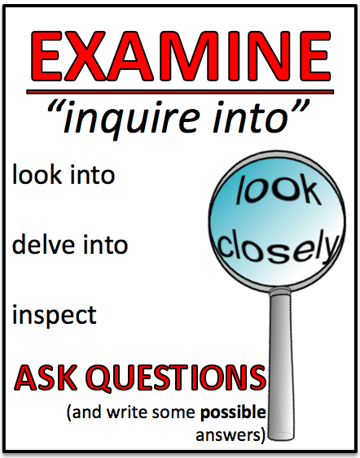
LEGAL REPRESENTATION
Including Legal Aid
Inquiry Q1
What are the rules about legal representation?
Inquiry Q2
Do defendants have a right to legal representation?
Inquiry Q3
What happens if a defendant can’t afford legal representation?
EXAMINE the role of legal representation in the criminal trial
LEGAL REPRESENTATION
Including Legal Aid

Slide 2
LEGAL REPRESENTATION
Inquiry Q1
What are the rules about legal representation?
Including Legal Aid
There are rules called the Solicitors’ Rules 2013.
They outline what lawyers are allowed (and not allowed…) to do.
There are sections about:
Relations with clients
Duties to the court
e.g. 4.1.2 be honest and courteous in all dealings in the course of legal practice
Relations with other lawyers

Slide 3
LEGAL REPRESENTATION
Inquiry Q1
What are the rules about legal representation?
Including Legal Aid
COMMON QUESTION: What does a defence lawyer do when she finds out her client is guilty?
Well, she usually just keeps on going, though since 2013 she has the option to cease being the person’s lawyer as long as the client doesn’t insist that she continue AND there’s enough time to find another lawyer.
However, There are certain things that she can no longer do (if she does, she could be in a lot of trouble).
For example, she can no longer ask the defendant on the witness stand whether or not he is guilty (because she knows he will be lying to the court).
A lawyer CANNOT, however, tell the court that her client told her secretly that he did it (UNLESS he asks for her help in committing a crime).

Slide 4
LEGAL REPRESENTATION
Inquiry Q2
Do defendants have a right to legal representation?
Including Legal Aid
A defendant has the
right to a FAIR TRIAL (Dietrich),
NOT a lawyer (McInnes).
So, you basically have the right to a lawyer IF you can’t get a fair trial without one
(e.g. in a murder case).

Slide 5
LEGAL REPRESENTATION
Inquiry Q3
What happens if a defendant
can’t afford legal representation?
Including Legal Aid
The Legal Aid Commission (LAC) can organise
legal advice
and/or
legal representation
This is a good thing!
It helps the defendant AND the judge.

Slide 6
LEGAL REPRESENTATION
3 tests to get Legal Aid…
Including Legal Aid
1. The Jurisdiction Test
What type of case will Legal Aid cover you for?
Criminal cases get priority over other types of cases
2. The Means Test
Do you make too much money to get Legal Aid?
Children can ALWAYS get Legal Aid though.
3. The Merit Test
Does your case have a reasonable chance of winning?
If not, they might say you should just plead guilty.

Slide 7
LEGAL REPRESENTATION
Including Legal Aid
Erosion – getting worn away; weakened
‘The Erosion of Legal Representation in the Australian Justice System’
Law Council of Australia
This report showed that, over time, there has been an erosion in the quality of legal representation in Australia because of CUTS TO LEGAL AID FUNDING
This has had a serious impact on our justice system because:
1. There is a rise in the number of people representing themselves
2. There are less experienced lawyers taking Legal Aid cases
3. Defendants are being pressured to plead guilty in order to get L.A 4. There are long delays in court, and cases go on for too long

Slide 8
LEGAL REPRESENTATION
Including Legal Aid
But the government has kept CUTTING Legal Aid’s money…
Almost 12,000 people were turned away from community legal services because of the government’s lack of funding for Legal Aid.
‘Crimes Against Justice’,
Lawyer’s Weekly (2012)

Slide 9
Questions
Question 1: How are lawyers meant to act according to the Solicitor's Rules 2013? (slide 2)
Question 2: How does this affect their actions if their client told them that he/she was guilty? (slide 3)
Question 3: In the textbook on page 58, it says (starts bottom left) "The High Court recognised this in a 1992 decision Dietrich v The Queen (1992) 177 CLR 292, which for the first time established a limited right to legal representation in Australia. What does this statement say about people's right to legal representation? Also see slide 4 of notes above.
Question 4: What happens if a defendant can't afford legal representation according to the Legal Aid Commission Act 1979 (NSW)? (slide 5)
Question 5: What are the 3 tests to get Legal Aid? Do you have to satisfy all of them? (slide 6)
Question 6: What is the state of Legal Aid in Australia according to Lawyer's Weekly? (slide 7-8)
Extension: What does this article say about legal representation http://www.smh.com.au/comment/cuts-to-legal-services-will-hurt-the-social-fabric-20160622-gpp26d.html.

