Slide 1
BURDEN OF PROOF
STANDARD OF PROOF
In a criminal case, it is the prosecution/state/Crown/Regina/R that has to prove that the person committed the crime.
If they say that a person is guilty of a crime, it is THEIR job to prove that the defendant DID commit the crime…
It is NOT the defendant’s job to prove that he/she is not guilty!

Slide 2
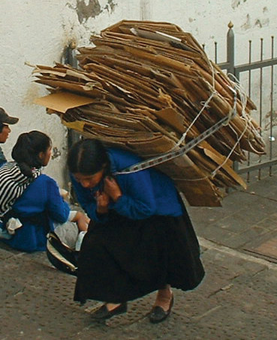
BURDEN OF PROOF
STANDARD OF PROOF
The proper way of saying this is that
the prosecution bears the burden of proof
(“burden” meaning that it is their job AND only their job)
So, yes, the defendant could sit in complete silence through their entire trial and still be found not guilty if the prosecution did not prove that he/she was guilty.
To “bear” a burden means to (metaphorically) carry it on your shoulders – you carry that burden, and ONLY you

Slide 3
BURDEN OF PROOF
STANDARD OF PROOF
The prosecution has to prove the defendant is guilty
BEYOND a REASONABLE DOUBT
This is the STANDARD of proof for criminal cases
(standard = how well you can prove it)
All this means is that they have to prove to the jury that you are guilty
so that there is no reasonable/sensible reason that the jury could NOT find you guilty

Slide 4
BURDEN OF PROOF
STANDARD OF PROOF
An example of a reasonable doubt:
The only witness at your murder trial first said that she saw you at the scene of the crime.
While she is being questioned on the witness stand, she says that her eyesight is actually quite bad at the time of night that she thought she saw you and that she had been smoking marijuana at the time.
She still seems quite sure it was you though.
An example of an unreasonable doubt:
Your lawyer tells the jury that you were abducted by aliens on the night of the crime
So, we try to avoid using percentages in Legal Studies, but the jury has to be 100% sure it was you. There can’t be ANY reasonable doubt in their heads that it was you.

Slide 5
BURDEN OF PROOF
STANDARD OF PROOF
BURDEN
OF PROOF
WHO needs to prove their side of the case?
The PROSECUTION ‘bears’ the burden of proof
STANDARD
OF PROOF
HOW WELL do they have to prove it?
Beyond a reasonable doubt

Slide 6
BURDEN OF PROOF
STANDARD OF PROOF
NEW PROBLEM:
Evidence Amendment (Evidence of Silence) Act 2013
Juries will now be told that if the defendant didn’t say anything when they were arrested that this might mean they’re guilty.
This is a way of
changing the BURDEN of Proof!!!
Right to remain not quite so silent (SMH, 2012)

Slide 7
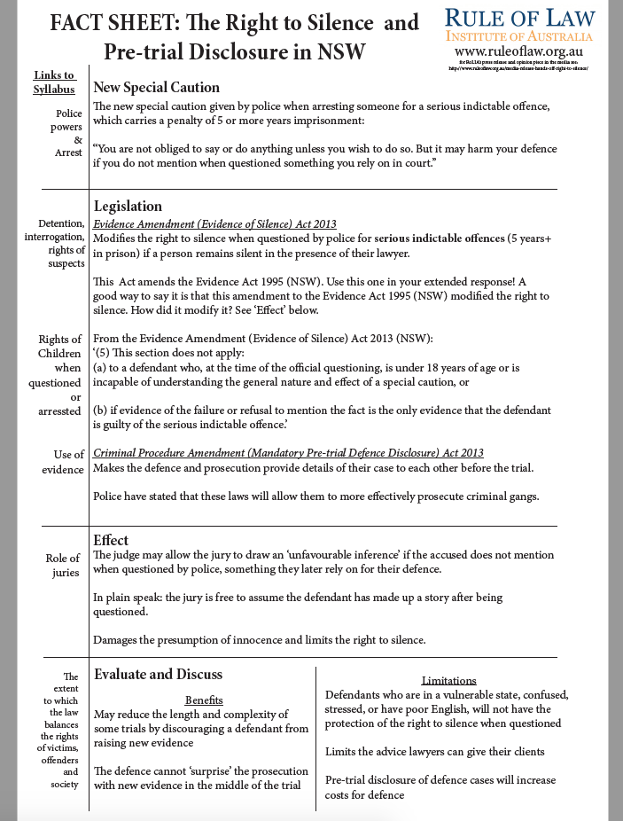

Slide 8
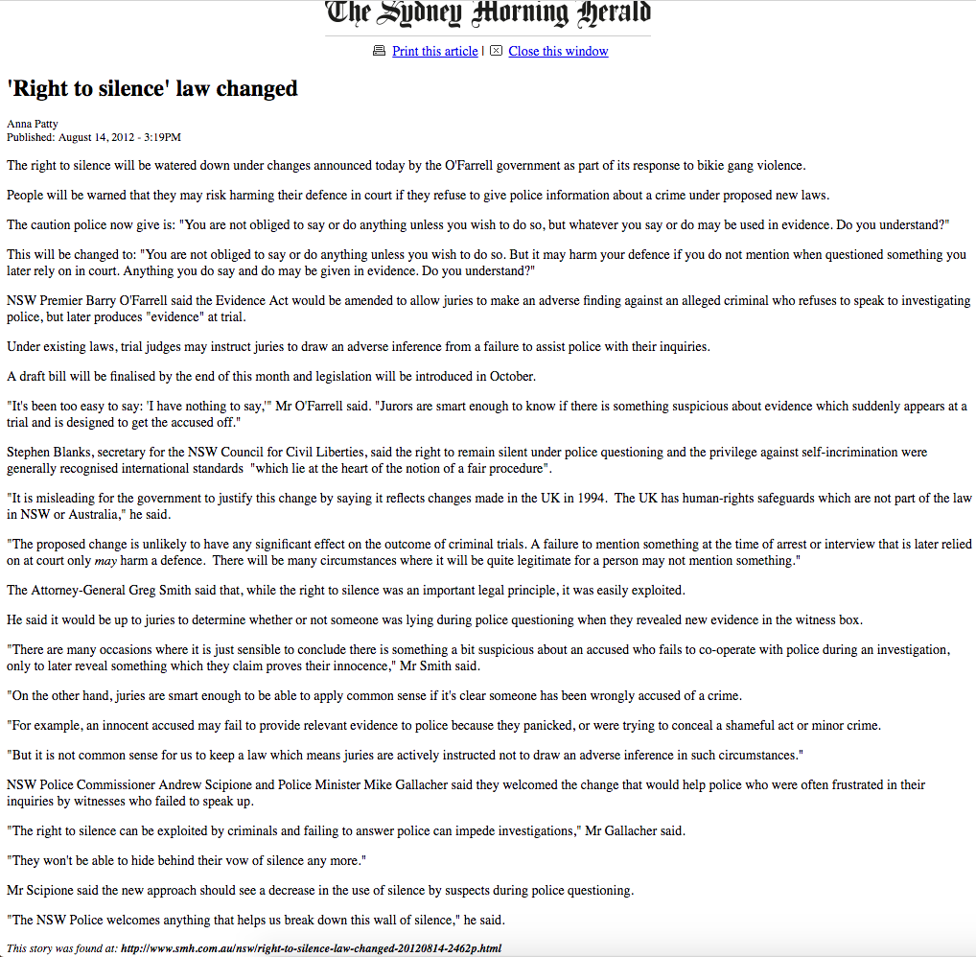

Slide 9
Questions
Question 1: Who carries the burden of proof in a trial? (slide 1)
Question 2: What is the standard of proof? Distinguish this from a burden of proof. (slide 2-3)
Question 3: How is the standard of proof in criminal cases being shifted by the Evidence of Silence rule? Remember we talked about how the Evidence of Silence rule has changed the investigation process but how does it affect the trial process? (slide 6-7)
Extension: Read article on end of these notes and make notes on what the Attorney General said about juries in the trial. Compare this view with Mr Scipione's, the Police Commissioner.
Further extension: distinguish between the standard of proof in a criminal case versus a civil case.

