Slide 1
USE OF EVIDENCE
Including witnesses
Main types of evidence
Physical
(especially DNA/scientific evidence)
Witnesses
People called to testify in court

Slide 2
USE OF EVIDENCE
Including witnesses
WITNESSES need to be:
1. Competent (they understand that they have to tell the truth)
e.g. No small children
2. Compellable (they can be forced to answer questions)
e.g. The Prosecution can’t make the defendant testify
e.g. No husbands or wives, parents or children (but they CAN volunteer)
e.g. Not the defendant’s lawyer or priest
(from the Evidence Act)

Slide 3
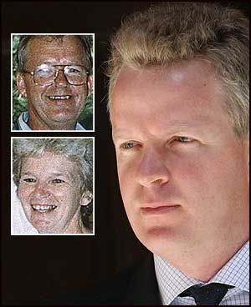
USE OF EVIDENCE
Including witnesses
Scientific evidence is sometimes used incorrectly:
Jeffrey Gilham (2012)
Jeffrey Gilham was found guilty in 1993 of murdering his parents.
He successfully appealed his conviction in 2012 and was released from prison.
The case showed that there are serious problems with the way our criminal justice system deals with scientific and medical evidence.

Slide 4
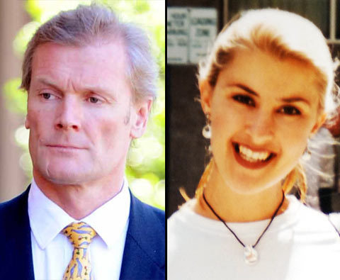
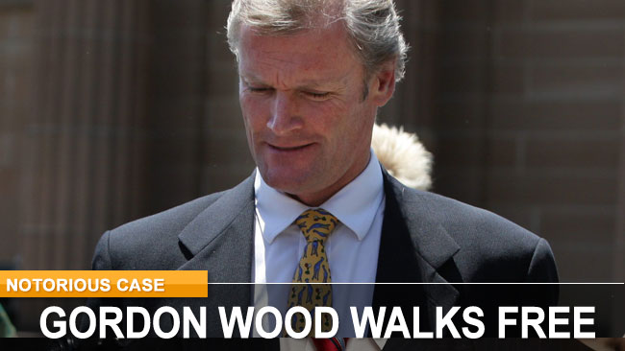
USE OF EVIDENCE
Including witnesses
Scientific evidence is sometimes used incorrectly:
Gordon Wood (2012)
Gordon Wood was found guilty of murdering model Caroline Byrne 16 years earlier.
The Prosecution’s case against him relied on expert evidence prepared by a physics professor about the position Ms Byrne's body was found in at the base of The Gap.
This evidence was found to be flawed and Wood was released.
Notes:
https://www.unisearch.com.au/resources/cases-relating

Slide 5
USE OF EVIDENCE
Including witnesses
Scientific evidence is sometimes used incorrectly:
Farah Jama (2010)
Farah Jama was found guilty of a rape and spent 16 months in prison before it was realised that the DNA evidence, and that was the only evidence that existed to be used against him, was contaminated, and in fact the rape probably never occurred. He was also given $550,000 compensation!
This again shows that there are real problems with DNA evidence. Sometimes it has been the ONLY evidence!!! What about witnesses? Motives?

Slide 6
USE OF EVIDENCE
Including witnesses
Problems with scientific evidence:
There isn’t even much scientific proof that the following types of evidence are completely accurate:
Voice comparison evidence
Fingerprints
Footprints on carpet
Stab wound comparisons
Photo comparisons
A lot of jurors get their beliefs about scientific evidence from watching CSI shows.
http://theconversation.com/the-csi-effect-are-jurors-starstruck-by-forensic-evidence-2066 7:30 Report (2012)

Slide 7
Questions
Question 1: What are the 2 conditions for a witness to take the stand and what legislation governs these laws?
Question 2: What was the reason given for the acquittal of Jeffrey Gilham? see notes and http://netk.net.au/GilhamHome.asp (1st paragraph)
Question 3: What was the reason for Gordon Wood's acquittal? See notes and https://www.unisearch.com.au/resources/cases-relating
Question 4: read article on http://theconversation.com/the-csi-effect-are-jurors-starstruck-by-forensic-evidence-2066 and consider what the CSI effect is.
Question 5: In the same article as above, does the article's author consider the CSI effect a justifiable reason to ban scientific evidence in court?
Question 6: what does the article 'Brothers freed after 30 years...' In our booklet tell us about the pitfalls of scientific evidence?

