Slide 1
DEFENCES TO CRIMINAL CHARGES
Complete Defences
Partial Defences to Murder
‘Defences’ are reasons/excuses for committing a crime that mean you don’t get the full punishment.
TWO TYPES of defences
Complete defences
Partial defences
(only for MURDER)
The defendant is found
NOT GUILTY
Mental Illness
Self-defence
Necessity
Duress
Consent
The defendant is
found GUILTY of MANSLAUGHTER
INSTEAD OF murder
Substantial impairment of responsibility
Provocation

Slide 2
DEFENCES TO CRIMINAL CHARGES
Complete Defences
Partial Defences to Murder
Using defences to “get out of” being fully punished for a crime is very controversial.
They are good for the defendant…
…but victims and society aren’t always happy

Slide 3
DEFENCES TO CRIMINAL CHARGES
Complete Defences
Partial Defences to Murder
So we need to DECIDE whether they’re really
achieving justice for defendants, victims and society
Syllabus ‘LEARN TO’:
Assess the use of defences to criminal charges in achieving justice

Slide 4
DEFENCES TO CRIMINAL CHARGES
Complete Defences
Partial Defences to Murder
Assess the use of defences to criminal charges in achieving justice
One GENERAL problem that victims groups and the DPP has had in the past is that defendants bring up defences as a SURPRISE, which makes it difficult for the DPP to argue against it.
So, the government passed a law to make it compulsory for defences to be ‘disclosed’ (brought up) BEFORE the trial (Criminal Procedure Amendment (Mandatory Pre-trial Defence Disclosure) Act 2013).
THIS IS GOOD FOR:
The Prosecution (DPP)
Victims
Society
THIS IS BAD FOR:
Defendants

Slide 5
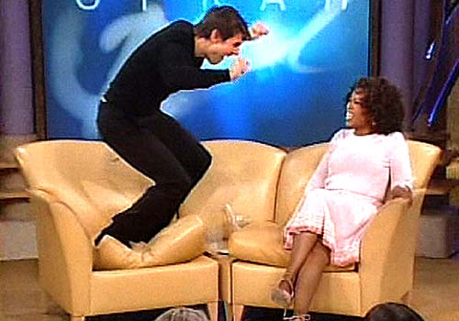
DEFENCES TO CRIMINAL CHARGES
Complete Defences
Partial Defences to Murder
Complete Defences: Mental Illness
AKA: “Insanity”
The basics of this defence are:
That the person must have a mental illness;
That mental illness prevented them from knowing that what they were doing was wrong;
If the defence works, they are found ‘not guilty’ by reason of mental illness (but usually have to go to a psychiatric institution).

Slide 6
DEFENCES TO CRIMINAL CHARGES
Complete Defences
Partial Defences to Murder
Complete Defences: Mental Illness
WHY ‘NOT GUILTY’???
BECAUSE THERE’S NO MENS REA HERE!
The defendant could not have intended to commit the crime because they were unable to understand that what they were doing was wrong.

Slide 7
DEFENCES TO CRIMINAL CHARGES
Complete Defences
Partial Defences to Murder
Complete Defences: Mental Illness
M’Naghten’s Case (1843)
This paranoid schizophrenic guy (called M’Naghten… don’t question his name, just memorise it) tried to murder the Prime Minister of England because he thought the PM’s Party was out to kill him.
He tried to shoot the PM, but missed and killed someone else instead!
M’Naghten was found not guilty because they realised that he was unable to know that what he was doing was wrong (as far as he was concerned, he was really in danger!).

Slide 8
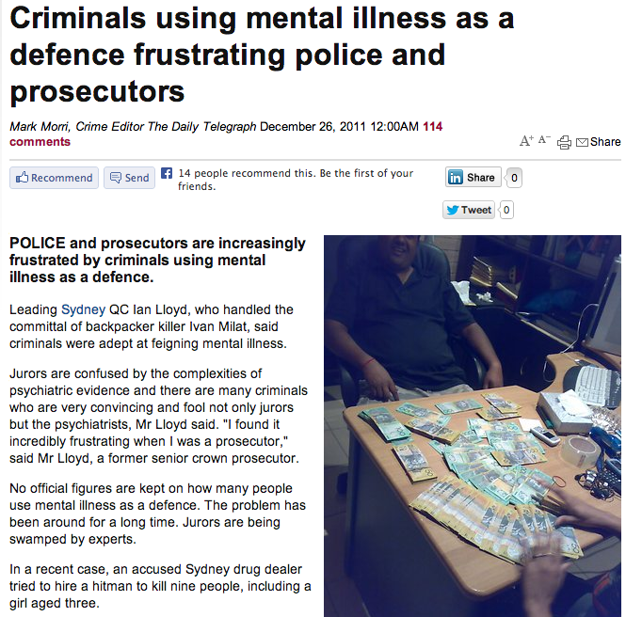
DEFENCES TO CRIMINAL CHARGES
Complete Defences
Partial Defences to Murder
Complete Defences: Mental Illness
Assess the use of defences to criminal charges in achieving justice
Movies (and newspapers like the Daily Telegraph) give society the idea that the Mental Illness defence is:
Used too much
An easy way out

Slide 9
DEFENCES TO CRIMINAL CHARGES
Complete Defences
Partial Defences to Murder
Complete Defences: Mental Illness
Assess the use of defences to criminal charges in achieving justice
BUT, the NSW Law Reform Commission report on Mental Illness (2012) and found two things:
The use of this defence is a lot MORE RARE than people think
An ‘insanity’ plea is not an easy way out. You still might end up being locked up FOR LIFE.

Slide 10
DEFENCES TO CRIMINAL CHARGES
Complete Defences
Partial Defences to Murder
Complete Defences: Mental Illness
Assess the use of defences to criminal charges in achieving justice
BUT, the NSW Law Reform Commission report on Mental Illness (2012) and found two things:
1. The use of this defence is a lot MORE RARE than people think
In Local Courts:
Only 1.4% of people end up getting found not guilty under section 32 or 33 of the Mental Health (Forensic Provisions) Act, but are usually released to the care of a responsible person (like a family member) or have to go to a ‘facility’ to be treated for their condition.
In the District Courts and Supreme Court:
There are usually only about 40 cases a year where the defendant even tries to use the Mental Illness defence under section 12 Mental Health (Forensic Provisions) Act of the and only about 24 actually work.

Slide 11
DEFENCES TO CRIMINAL CHARGES
Complete Defences
Partial Defences to Murder
Complete Defences: Mental Illness
Assess the use of defences to criminal charges in achieving justice
BUT, the NSW Law Reform Commission report on Mental Illness (2012) and found two things:
2. An ‘insanity’ plea is not an easy way out. You still might end up being locked up for life.
Even though the defendant is found not guilty, they DON’T JUST GO STRAIGHT HOME.
The court usually orders that they be detained (“kept”) in a mental health facility, OR EVEN A PRISON, for an ‘indeterminate’ time (there’s NO MAXIMUM TIME – IT COULD BE FOR LIFE!).
There is a Mental Health Review Tribunal (“MHRT”) that assesses the person once they’re found not guilty, then the person is ‘detained’, usually for treatment of their disease, then the MHRT checks regularly to see if it is safe to let them leave.

Slide 12
DEFENCES TO CRIMINAL CHARGES
Complete Defences
Partial Defences to Murder
Complete Defences: Self-Defence
This is when the defendant did what he thought was needed to defend himself, or someone else, from a threat.
R v Katarzynski (2002)
(KAT-AR-ZIN-SKI)

Slide 13
DEFENCES TO CRIMINAL CHARGES
Complete Defences
Partial Defences to Murder
Complete Defences: Self-Defence
For ‘self-defence’ to be accepted:
The amount of force the defendant used has to be ‘proportionate’ to the threat.
e.g. You can’t stab someone if they are about to punch you (McInnes)
The threat doesn’t have to be REAL. The defendant just has to be defending himself from WHAT HE THINKS is the threat (the ‘perceived threat’).
e.g. If someone threatened him with a gun, but he didn’t know it was fake, he can still defend himself.

Slide 14
DEFENCES TO CRIMINAL CHARGES
Complete Defences
Partial Defences to Murder
Complete Defences: Necessity
This can be used when the consequences of NOT committing the crime would have been WORSE than the consequences OF committing the crime.

Slide 15
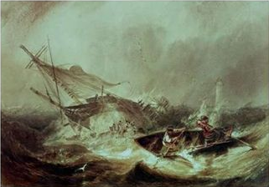
DEFENCES TO CRIMINAL CHARGES
Complete Defences
Partial Defences to Murder
Complete Defences: Necessity
This defence DIDN’T WORK in:
Dudley and Stephens v R (1884)
These guys were stranded at sea for 20 days. They thought they’d starve, so they killed a boy and ate him. They didn’t even enjoy the meal…
The strange thing about this case is that the judge ruled that the defence of necessity still couldn’t be used here. Apparently the men COULD still have been rescued, so it wasn’t yet necessary to commit this crime.

Slide 16
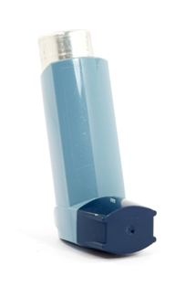
DEFENCES TO CRIMINAL CHARGES
Complete Defences
Partial Defences to Murder
Complete Defences: Necessity
This defence DID WORK in:
R v White (1987).
Mr White was caught speeding and got fined, but appealed the fine because he said he was rushing his son to hospital (the boy was apparently having an asthma attack).
The judge said his son dying would have been WORSE THAN the consequences of speeding.
Therefore, there was a necessity for the crime to be committed.

Slide 17
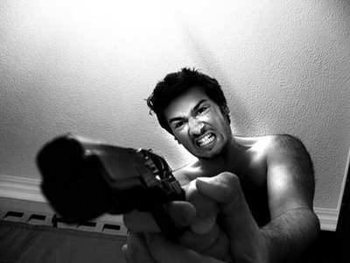
DEFENCES TO CRIMINAL CHARGES
Complete Defences
Partial Defences to Murder
Complete Defences: Duress
If you do something under duress, you are doing it because someone is threatening you.
As a defence, you have to prove that you genuinely believed that your life or someone else’s life was in danger if you did NOT commit the crime.
R v Williamson (1972)
A guy (Williamson) disposed of a body for someone else while under the threat of death (i.e. “Bury this body or I’ll kill you”).

Slide 18
DEFENCES TO CRIMINAL CHARGES
Complete Defences
Partial Defences to Murder
Complete Defences: Consent
If you ‘consent’ to something, ALLOW it to happen.
Some things are only crimes if you DON’T consent to them happening.
For example, sex between adults is legal. If one of them doesn’t consent, then it is against the law.
So, you can use the fact that the victim consented to what you did as a defence to a crime.
For example, if you are walking down the street, you do not consent to some guy running up and tackling you. If someone does that, they are assaulting you.
However, if you go onto a football field to play a game of tackle football, you do consent to getting tackled. So, if one of the other players ended up in court because he tackled you, you could use consent as a defence.

Slide 19
DEFENCES TO CRIMINAL CHARGES
Complete Defences
Partial Defences to Murder
Complete Defences: Consent
Assess the use of defences to criminal charges in achieving justice
You CAN’T use consent as a defence to MURDER/MANSLAUGHTER.
This is why euthanasia is illegal – you can’t consent to having someone take your life (in NSW).
This has been a very controversial area of the law.
Why can you kill yourself, but if you’re disabled and you need help to do it, that person is a criminal?
Euthanasia laws can be very difficult to make though.
How do you stop someone from lying about whether the person really consented?
How do you stop people from being pressured into giving their consent? Like an old lady?

Slide 20
Questions
Question 1: As you look at this, what theme and challenge does complete defences relate to immediately?
Question 2: What is the Mandatory Pre-trial disclosure amendment and who is this good for?
Question 3: List the 5 complete defences. Which ones do you think are most relevant to today's society and the way that it functions?
Question 4: What is the difference between a complete defence and a partial defence?
Question 5: What are the three parts to the defence of Mental Illness? Why is this a complete defence?
Question 6: How does the 2011 Daily Telegraph article on Mental Illness give an incorrect bias on the defence? How do we know that this is an incorrect bias?
Question 7: Define the complete defence of Self-defence. What is the test that must be satisfied for self-defence?
See http://www.smh.com.au/nsw/murder-and-selfdefence-how-far-can-you-go-to-protect-yourself-in-a-home-invasion-20160328-gnsq7q.html. Who's point of view is the proportionate response from?

