Slide 1
DEFENCES TO CRIMINAL CHARGES
Complete Defences
Partial Defences to Murder
Partial Defences to Murder
Sometimes a defence does not completely excuse what you have done, but there is some reason for what you did.
These are called partial defences
These defences only work with murder cases.
They reduce a person’s charge
from ‘murder’ to ‘manslaughter’

Slide 2
DEFENCES TO CRIMINAL CHARGES
Complete Defences
Partial Defences to Murder
Partial Defences to Murder
WHY DOES IT MATTER if you’re charged with ‘Murder’ or ‘Manslaughter’?
Because the
penalties are VERY different…

Slide 3
DEFENCES TO CRIMINAL CHARGES
Complete Defences
Partial Defences to Murder
Partial Defences to Murder
MURDER:
    Average jail time: 18 years (13.5 non-parole)
    Shortest sentence: 9 years
MANSLAUGHTER:
    Average jail time: 7 years (4 non-parole)
    Shortest sentence: 0 (10% didn’t get full time prison)

Slide 4
DEFENCES TO CRIMINAL CHARGES
Complete Defences
Partial Defences to Murder
Partial Defences to Murder: Provocation
Would an “ordinary person” also kill the victim?

Slide 5
DEFENCES TO CRIMINAL CHARGES
Complete Defences
Partial Defences to Murder
Partial Defences to Murder: Provocation
e.g. R v Camplin (1978)
A 15 year-old boy’s uncle raped him and then laughed at the kid about what had happened.
The boy hit his uncle on the head with a frying pan and killed him, even though there was no threat (so it wasn’t in self-defence).
Would an ordinary person do the same thing? YES!
So it WAS seen as provocation (the victim provoked the boy to do it).

Slide 6
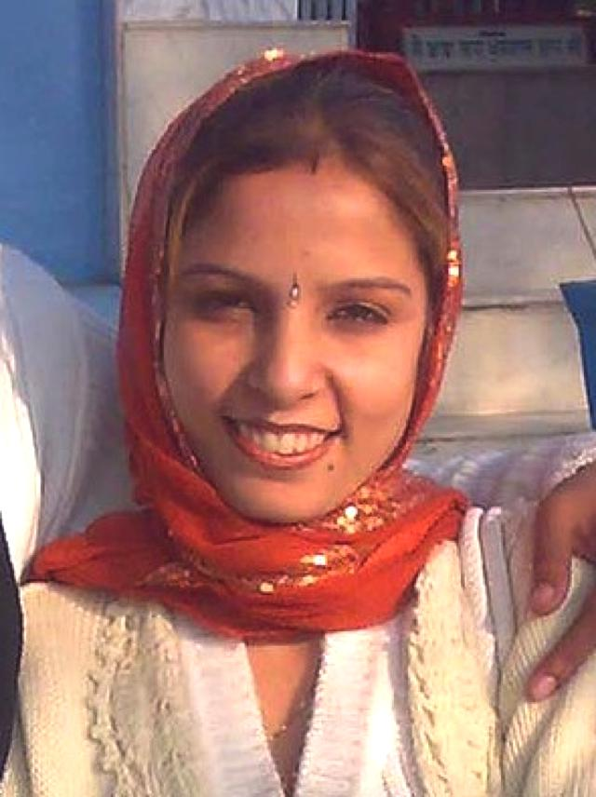
DEFENCES TO CRIMINAL CHARGES
Complete Defences
Partial Defences to Murder
Partial Defences to Murder: Provocation
Assess the use of defences to criminal charges in achieving justice
CONTROVERSIAL CASES:
R v Singh (2012)
Mr Singh got 6 years for killing his wife after she told him she wanted a divorce.
R v Won (2012)
Husband killed his wife’s lover after finding them in bed together. He received 7½ years

Slide 7
DEFENCES TO CRIMINAL CHARGES
Complete Defences
Partial Defences to Murder
Partial Defences to Murder: Provocation
Assess the use of defences to criminal charges in achieving justice
This caused politicians to ask whether we should still have this defence if cases like this keep happening.
So NSW parliament created a Provocation Committee to look at whether we should keep the defence.

Slide 8
DEFENCES TO CRIMINAL CHARGES
Complete Defences
Partial Defences to Murder
Partial Defences to Murder: Provocation
Assess the use of defences to criminal charges in achieving justice
KEEP IT (it IS achieving justice)
Women who are victims of domestic violence for many years sometimes “finally crack” and kill their partner when he’s not abusing them at the time. These women can’t use ‘self-defence’ because there was no threat. They NEED to use ‘provocation’.
REMOVE IT (it is NOT achieving justice)
Victoria already got rid of the defence in 2005, just after the Ramage case (a guy only got 11 years for killing his wife for insulting him).
The defence has been used as a ‘gay panic defence’ by straight guys who kill gay men just because the guy hit on them (Green v The Queen). Women don’t get to kill men who hit on them, so why should they be able to do this?

Slide 9
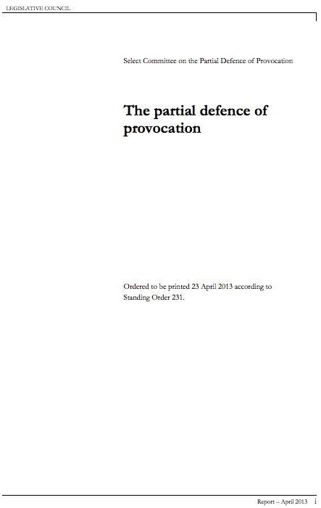
DEFENCES TO CRIMINAL CHARGES
Complete Defences
Partial Defences to Murder
Partial Defences to Murder: Provocation
Assess the use of defences to criminal charges in achieving justice
The Provocation Committee recommended to parliament that we should:
KEEP it
(it IS achieving justice for women who were long term victims of domestic violence)
but
CHANGE it
(so that men cannot argue that their wife offending their manhood or a gay guy hitting on them counts as being provoked)

Slide 10
DEFENCES TO CRIMINAL CHARGES
Complete Defences
Partial Defences to Murder
Partial Defences to Murder: Provocation
Assess the use of defences to criminal charges in achieving justice
They said we should change it to
Gross
Provocation

Slide 11
DEFENCES TO CRIMINAL CHARGES
Complete Defences
Partial Defences to Murder
Partial Defences to Murder: Provocation
Assess the use of defences to criminal charges in achieving justice
The law did change afterwards to include the defence of extreme provocation!!!

Slide 12
DEFENCES TO CRIMINAL CHARGES
Complete Defences
Partial Defences to Murder
Partial Defences to Murder:
Substantial impairment of responsibility
SUBSTANTIAL = serious
IMPAIRMENT = thing that holds you back
OF = from (?)
RESPONSIBILITY = being completely responsible for what you did

Slide 13
DEFENCES TO CRIMINAL CHARGES
Complete Defences
Partial Defences to Murder
Partial Defences to Murder:
Substantial impairment of responsibility
This is kind of like insanity, but with insanity you have to have a mental illness ALL the time that stops you from EVER understanding that what you were doing was wrong.
With substantial impairment of responsibility, you just have to have an abnormality of the mind that caused them to carry out the crime, but they are otherwise not insane!
ABNORMALITY = SOMETHING DIFFERENT/WRONG
OF THE MIND = OF THAT WARM THING BETWEEN YOUR EARS

Slide 14
DEFENCES TO CRIMINAL CHARGES
Complete Defences
Partial Defences to Murder
Partial Defences to Murder:
Substantial impairment of responsibility
This defence is more common than mental illness because it is MUCH EASIER to prove since the person can be normal in every other way
Byrne v R (1960) - The defendant had no control over his violent sexual fantasies. Other than this the guy was pretty normal.
He strangled a young woman to death while he was delusional.
The court accepted that the guy had an abnormality of mind which substantially impaired his capacity to take responsibility for his actions.
Because he wasn’t crazy when he wasn’t around women and wasn’t having these fantasies, he couldn’t use the mental illness/insanity defence.
He was found guilty of manslaughter instead of murder.

Slide 15
Questions
Question 1: Distinguish between the average punishments for murder as opposed to manslaughter.
Question 2: Define the defence of provocation.
Question 3: Outline what the Provocation Committee found on the defence of provocation and how this has been adopted in NSW.
Question 4: Define the defence of substantial impairment of responsibility.
Question 5: How is substantial impairment of responsibility different from the complete defence of mental impairment we spoke about yesterday?
Question 6: Look up section 22A of the Crimes Act 1900 (NSW) and identify whether infanticide is a complete or partial defence to murder.
Question 7: (Extension) Just like self-defence is a controversial defence in complete defences, the controversial one here is provocation. This article offers some extra reading on provocation. Make notes on the article. http://www.sydneycriminallawyers.com.au/blog/abolishing-the-partial-defence-of-provocation-an-interview-with-dr-kate-fitz-gibbon/

