Slide 1
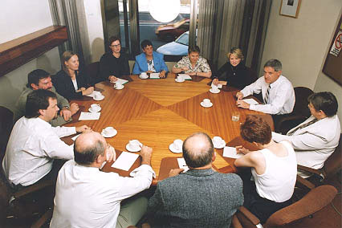
THE ROLE OF JURIES
Juries decide on ‘questions of fact’
e.g. Did the defendant commit the crime?
They decide on the ‘verdict’
Guilty or Not Guilty
Jury trials are RARE. Only about 3% of criminal trials in NSW used juries last year.
When making their decision, they can only use the evidence the judge allowed into the trial. They are not allowed to investigate for themselves.

Slide 2
THE ROLE OF JURIES
In the syllabus:
EVALUATE the effectiveness of the jury system in the criminal trial
PROBLEM 1: Juries sometimes do their own investigating. This causes serious problems:
If the judge finds out that jurors did any of their own investigating, it will cause a mistrial.
e.g. In the first Bilal Skaf case, they had to have a new trial because a couple of the jurors went out to the scene of the crime and investigated it for themselves.

Slide 3
THE ROLE OF JURIES
In the syllabus:
EVALUATE the effectiveness of the jury system in the criminal trial
PROBLEM 1: Juries sometimes do their own investigating. This causes serious problems:
This is a difficult problem to fix.
Even when it’s a crime, jurors STILL do their own research.
Jurors often research because they’re too afraid to ask the judge questions (e.g. “What do reasonable doubt mean?”, which is the question someone googled in Victoria and it caused a mistrial).
Jurors playing detective should not be a crime (SMH 2013)

Slide 4
THE ROLE OF JURIES
In the syllabus:
EVALUATE the effectiveness of the jury system in the criminal trial
PROBLEM 2: Juries can’t be forced to listen:
A District Court judge has to discharge (sack) a jury in a major drug trial because the jurors were playing Sudoku for “more than half” the trial… The trial had cost over a million dollars and had seen 105 witnesses. Huge waste.
Drug Trial Abandoned after jurors play Sudoku (ABC 2008)

Slide 5
THE ROLE OF JURIES
In the syllabus:
EVALUATE the effectiveness of the jury system in the criminal trial
PROBLEM 2: Juries can’t be forced to listen:
Some people used this as a reason to argue against using juries (we should just have judges). But judges aren’t exactly perfect.
Cesan (2007): A judge fell asleep for long periods during a trial.
The defendant appealed, but the appeals judge said that the first judge falling asleep is NOT a reason by itself to cause a mistrial (even though it IS against section 80 of the CONSTITUTION!!!).
SO → Sleeping judge – fine. Sudoku-playing jury – BAD.

Slide 6
THE ROLE OF JURIES
In the syllabus:
EVALUATE the effectiveness of the jury system in the criminal trial
PROBLEM 3: Juries don’t always understand the judge’s instructions:
At the end of a trial (where there is a jury), the JUDGE SUMS UP the facts of the case AND gives the jurors some INSTRUCTIONS.
e.g. “If you have any reasonable doubt that the defendant committed this crime, you must find him not guilty”

Slide 7
THE ROLE OF JURIES
In the syllabus:
EVALUATE the effectiveness of the jury system in the criminal trial
PROBLEM 3: Juries don’t always understand the judge’s instructions:
BOCSAR (2008) found that only 67% of jurors said that they understood everything the judge said.
AND some of them were probably lying to the researchers.
When researchers have actually ASKED jurors questions, it turns out that only 55% of jurors even understand the what ‘beyond a reasonable doubt’ means!!! That’s the MOST BASIC THING they need to understand to do their job!!!

Slide 8
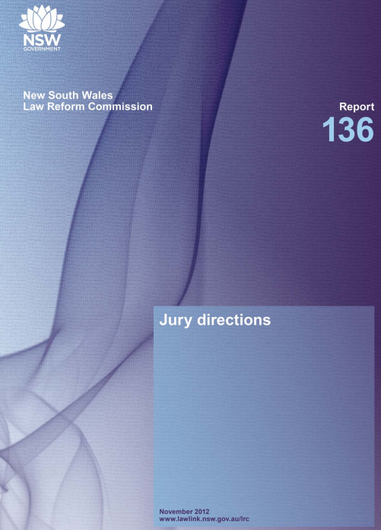
THE ROLE OF JURIES
In the syllabus:
EVALUATE the effectiveness of the jury system in the criminal trial
PROBLEM 3: Juries don’t always understand the judge’s instructions:
This issue was so bad that the NSW Law Reform
Commission was asked to look at ways of fixing it.
They recommended that in summing up, judges:
Should explain things more clearly
Use visual aids (like PowerPoint presentations)
Use flowcharts (to help decision-making)
Judges should also encourage questions from jurors
(even throughout the trial!). Jury Directions, NSWLRC Report 136 (2012)

Slide 9
THE ROLE OF JURIES
In the syllabus:
EVALUATE the effectiveness of the jury system in the criminal trial
PROBLEM 4: Social media makes jury trials difficult:
Because social media has allowed anyone to publish comments about the defendant, the defendant might be able to argue that he can't get a fair trial (because the jurors will already have read things that would not be allowed in evidence in the actual trial).
This was a big worry in the Jill Meagher case in Victoria. As soon as the name of the defendant came out, people started commenting on Facebook. The Victorian Police warned people about the dangers of this (because the defendant could say that the jury is already biased).

Slide 10
THE ROLE OF JURIES
In the syllabus:
EVALUATE the effectiveness of the jury system in the criminal trial
HOWEVER: Juries can sometimes “do the right thing” when judges wouldn’t:
The jury in the Cairns abortion case (R v Leach (2010)) really over-ruled the law by returning a not guilty verdict.
SHE WAS GUILTY of “the crime”, but the jury didn’t feel she deserved to be found guilty of a law that most of society finds unacceptable, so the jury ignored their instructions and “did the right thing” instead.
‘Did abortion jury ignore law in favour of common sense?’
(SMH 2010)

Slide 11
THE ROLE OF JURIES
Including Verdicts
Does every juror have to vote the same way?
Before 2006:
Jurors USED to have to reach a ‘UNANIMOUS verdict’
(meaning that they all had to vote the same way, 12-0).
Since 2006:
The Juries (Amendment) Act 2006 (NSW) brought in ‘MAJORITY verdicts’.
This means that in a criminal trial, the voting can go 11-1 and STILL be counted as a proper verdict (or 10-1).

Slide 12
THE ROLE OF JURIES
Including Verdicts
EVALUATE the effectiveness of the jury system in the criminal trial
Do ‘majority verdicts’ achieve justice?
From ‘Majority Verdicts’ NSW Law Reform Commission (2005)
Arguments FOR majority verdicts | Arguments AGAINST majority verdicts
Quicker and easier verdicts | Verdicts may be reached without enough negotiation time
A juror that has some doubts has less pressure to “conform” with what the rest of the group is saying | Majority verdicts are against the standard of proof (if one juror says no – isn’t THAT a reasonable doubt?)
Gets rid of the “rogue juror” effect (when one nutcase that won’t change their mind) | Only resolves an extra 1.7% of criminal cases (which would have been “hung verdicts” without majority verdicts)

Slide 13
THE ROLE OF JURIES
Including Verdicts
One more controversial thing about juries...
Juries can be overruled by the judge if they have found someone guilty when the judge thinks they shouldn’t have!
In R v Leung (2009, 2011 and 2013), the defendant was found guilty TWICE by two different juries, but in BOTH situations, the judge gave a ‘directed verdict’ of Not Guilty.
So, he was put on trial, found guilty of murder by a jury, but the jury was overruled by the judge, so they charged him again, put on trial again, he was found guilty again by a jury, but the jury was again overruled by the judge, so he was charged AGAIN, put on trial for a THIRD TIME, and found guilty by the jury (but they weren’t overruled by the judge then).
He’s now serving 8 years in jail by the way.

Slide 14
Questions
Question 1: I want you guys to think about this essay question - "evaluate the effectiveness of juries in achieving justice." Instead of answering the question, I want you guys to create a table of 2 columns and list all the pieces of evidence from these notes that show juries achieving justice (in one column) and all the pieces of evidence that show juries not achieving justice (in the other column).

