Slide 1
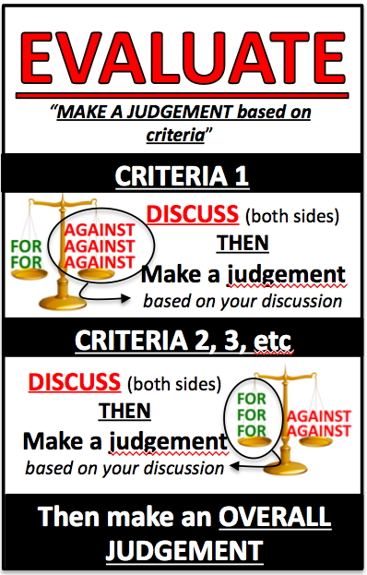
EVALUATE the effectiveness of the domestic and international legal systems in dealing with international crime
DOMESTIC measures:
We have been ACTIVE in:
Signing international agreements
Passing domestic laws to reflect those agreements
Funding agencies to fight international crime

Slide 2
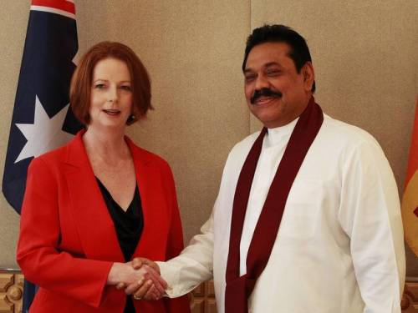
EVALUATE the effectiveness of the domestic and international legal systems in dealing with international crime
DOMESTIC measures:
We have been CRITICISED for:
Not being active in prosecuting people accused of international crimes.
e.g. Our A-G refused to allow President Rajapaksa of Sri Lanka to be indicted for war crimes. Our Criminal Code should be amended to stop this from happening. He should at least have been referred to the ICC.

Slide 3
EVALUATE the effectiveness of the domestic and international legal systems in dealing with international crime
DOMESTIC measures:
“There just does not seem to be enough political capital in prosecuting people who have committed horrendous atrocities against people in other countries, whether they now live in Australia or not”.
War crimes in Australia's too-hard basket? (ABC 2011)

