Slide 1
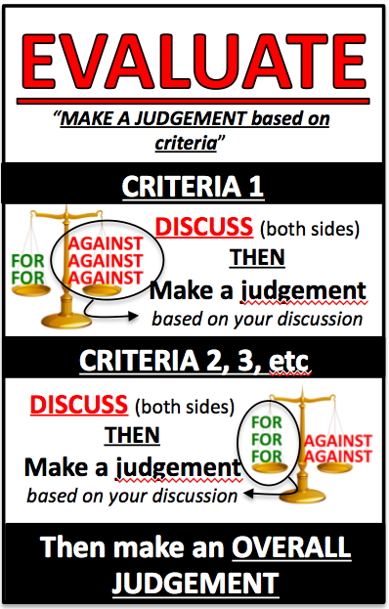
EVALUATE the effectiveness of the domestic and international legal systems in dealing with international crime
INTERNATIONAL measures:
Given that you have to evaluate the effectiveness of domestic and international legal systems in dealing with international crime, it helps to have a reliable source of information and arguments.
Luckily, there’s a Professor at UWS, Steven Freeland, who actually works in the international criminal justice system, who wrote a conveniently named paper called
Effectiveness of International Criminal Justice (2008)
The arguments and statistics used by Freeland are perfect for answering this question, so I’ve made a summary here:

Slide 2
EVALUATE the effectiveness of the domestic and international legal systems in dealing with international crime
INTERNATIONAL measures:
Focusing on crimes against humanity, and the effectiveness of ad hoc tribunals and the ICC in dealing with these crimes:
Steven Freeland outlines 3 MAIN CRITERIA that could be used to make a judgement about the effectiveness of the international legal system in dealing with international crime:
CRITERIA 1 – HAS OUR INTERNATIONAL LEGAL SYSTEM STOPPED OR REDUCED THE NUMBER OF WARS?
Wars continue around the world, and there are still reports of crimes against humanity going on (Darfur, Congo, etc) | International criminal law isn’t really going to be able to stop these crimes from taking place – just punish those who commit them. Violent conflict may just be inevitable between humans. World leaders need to ensure that international law is respected at all times in order for it to be effective.
 | International law is not as good in dealing with current conflicts because most current conflicts are INTERNAL, and international law is weak in dealing with internal issues (due to state sovereignty)
 | How is international law supposed to stop non-state actors (e.g. terrorist organisations, militia groups, etc)?

Slide 3
EVALUATE the effectiveness of the domestic and international legal systems in dealing with international crime
INTERNATIONAL measures:
CRITERIA 2 – HAVE THERE BEEN A LOT OF PROSECUTIONS?
There have been less than 200 people prosecuted by the ad hoc tribunals and the ICC. By 2015, the world will have spent $6.3 billion on international courts and tribunals. | These courts were only ever designed to prosecute those people who were the MOST responsible for crimes against humanity (not every person involved). They are not supposed to replace domestic courts (the domestic legal system can deal with the individual cases of those responsible for the individual crimes).
 | The whole idea is to make sure that the most powerful people can be prosecuted for all of their crimes (which takes a lot of time, money and political will to do) – but can create powerful precedents for future leaders who want to commit these crimes
 | While the “big” trials for the leaders have been happening, there have also been millions of cases heard in courts like the Gacaca Traditional Courts in Rwanda.
 | “How much international criminal justice are we prepared to pay for?”

Slide 4
EVALUATE the effectiveness of the domestic and international legal systems in dealing with international crime
INTERNATIONAL measures:
CRITERIA 3 – ARE INTERNATIONAL CRIMINALS MORE ACCOUNTABLE?
Heads of State (leaders of countries) used to see themselves as being above the law
This is no longer the case*
With prosecutions of former powerful leaders
(Saddam Hussein, Charles Taylor, Slobodan Milošević),
leaders are now aware that
they may be held accountable for crime against humanity –
EVEN IF IT IS WITHIN THEIR OWN BORDERS
(this would have been unthinkable 15 years ago)
But there is more work to be done…
We just have to rely on the political will of world leaders to hold international criminals responsible for what they have done.
*Unless you’re the leader of a white, English-speaking country…

